Slide 1
CSC1003 Practice 2
OJ Registration and Rules of Grading

Slide 2
Overview
How to register on OJ
The grading rules of assignments
Practice on OJ

Slide 3
OJ Registration
OJ link: https://oj.cuhk.edu.cn/d/csc1003_2025_fall/ (neither “https://oj.cuhk.edu.cn” nor “https://oj.cuhk.edu.cn/d/csc1003_2025_fall” works! You need to copy the whole link!)
How to register:
    Step 1: Access https://oj.cuhk.edu.cn/d/csc1003_2025_fall/
    Step 2: Click “Login” button at the top-right corner
    Step 3: Click “Forgot password or username?” button
    Step 4: Enter your email (student_id@link.cuhk.edu.cn) and send reset email
    Step 5: Check your email and reset your password, and then login (username is your student id instead of your email).

Slide 4
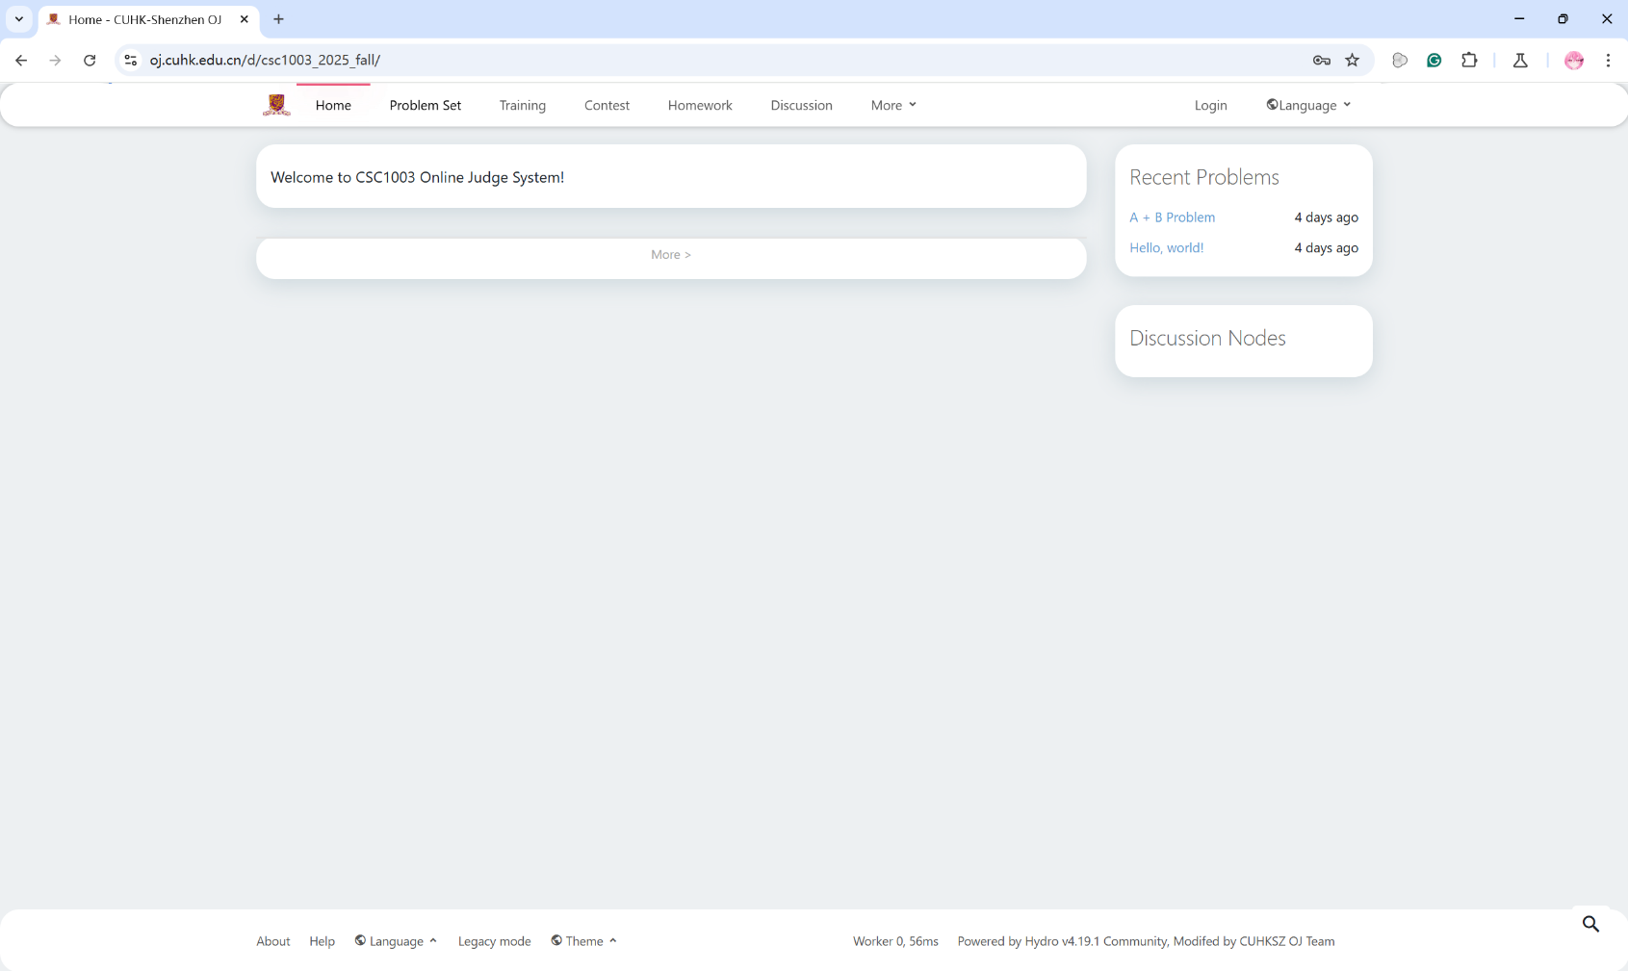
OJ Registration
Step 1: Access https://oj.cuhk.edu.cn/d/csc1003_2025_fall/

Slide 5
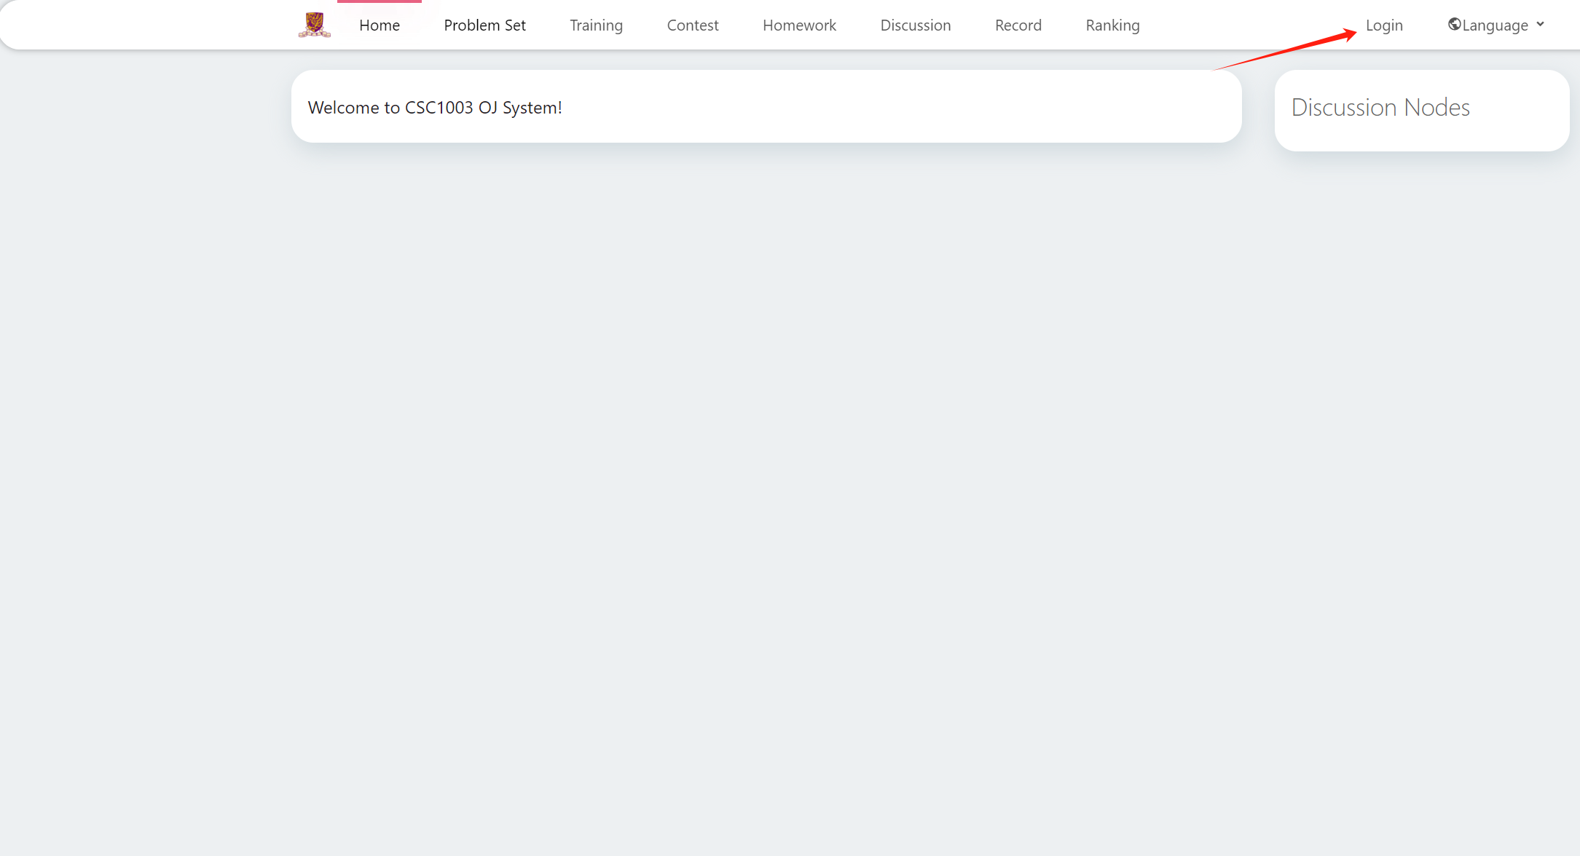
OJ Registration
Step 2: Click “Login” button at the top-right corner

Slide 6
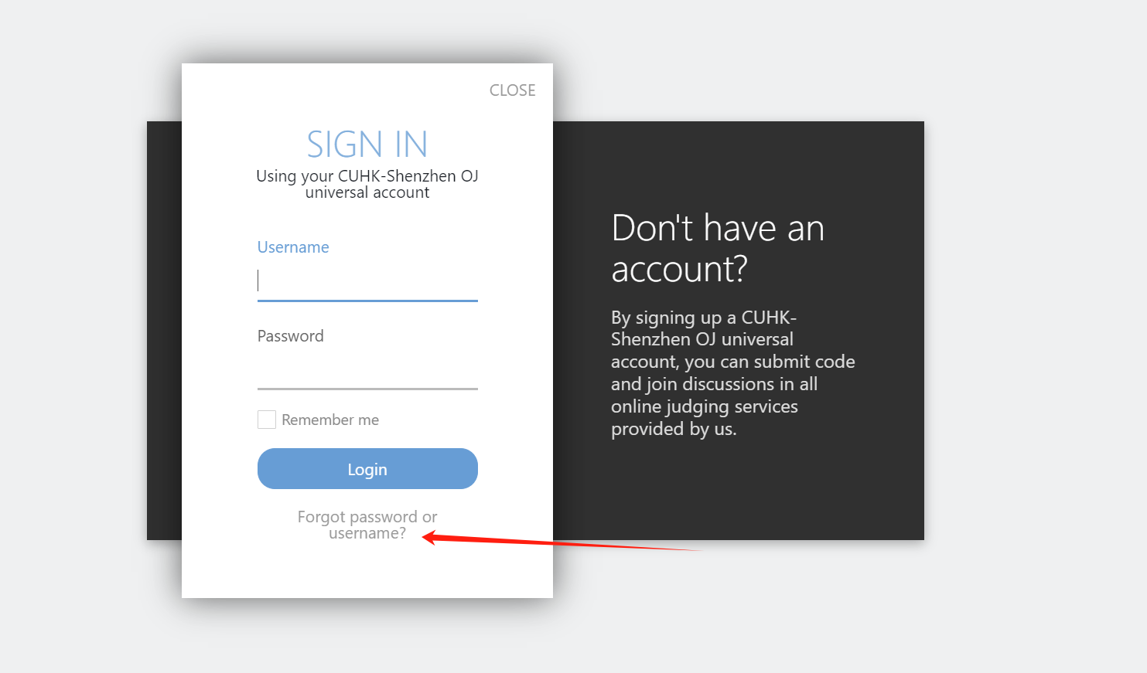
OJ Registration
Step 3: Click “Forgot password or username?” button

Slide 7
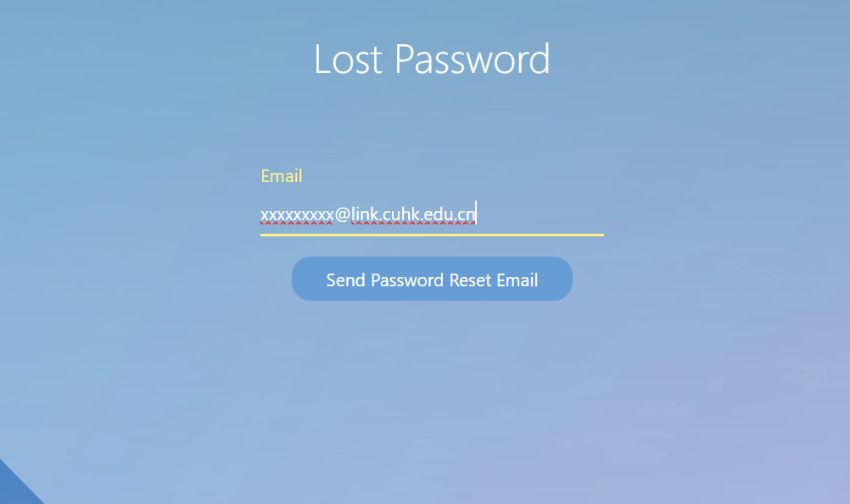
OJ Registration
Step 4: Enter your email (student_id@link.cuhk.edu.cn) and send reset email

Slide 8
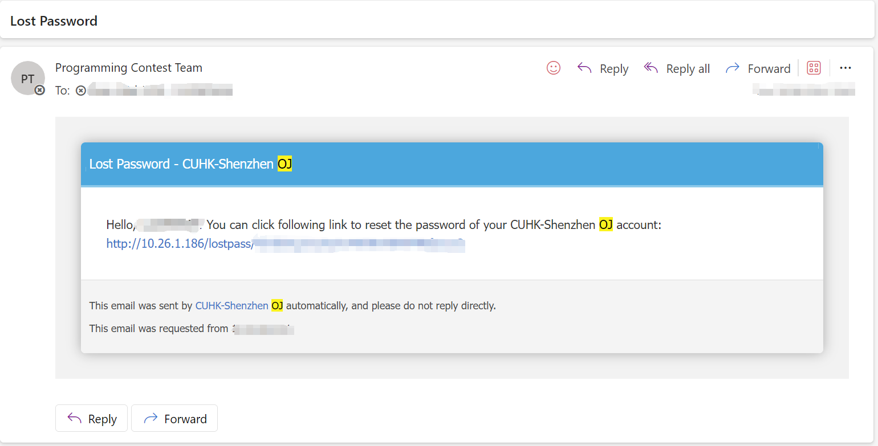
OJ Registration
Step 5: Check your email and reset your password, and then login (username is your student id instead of your email).

Slide 9
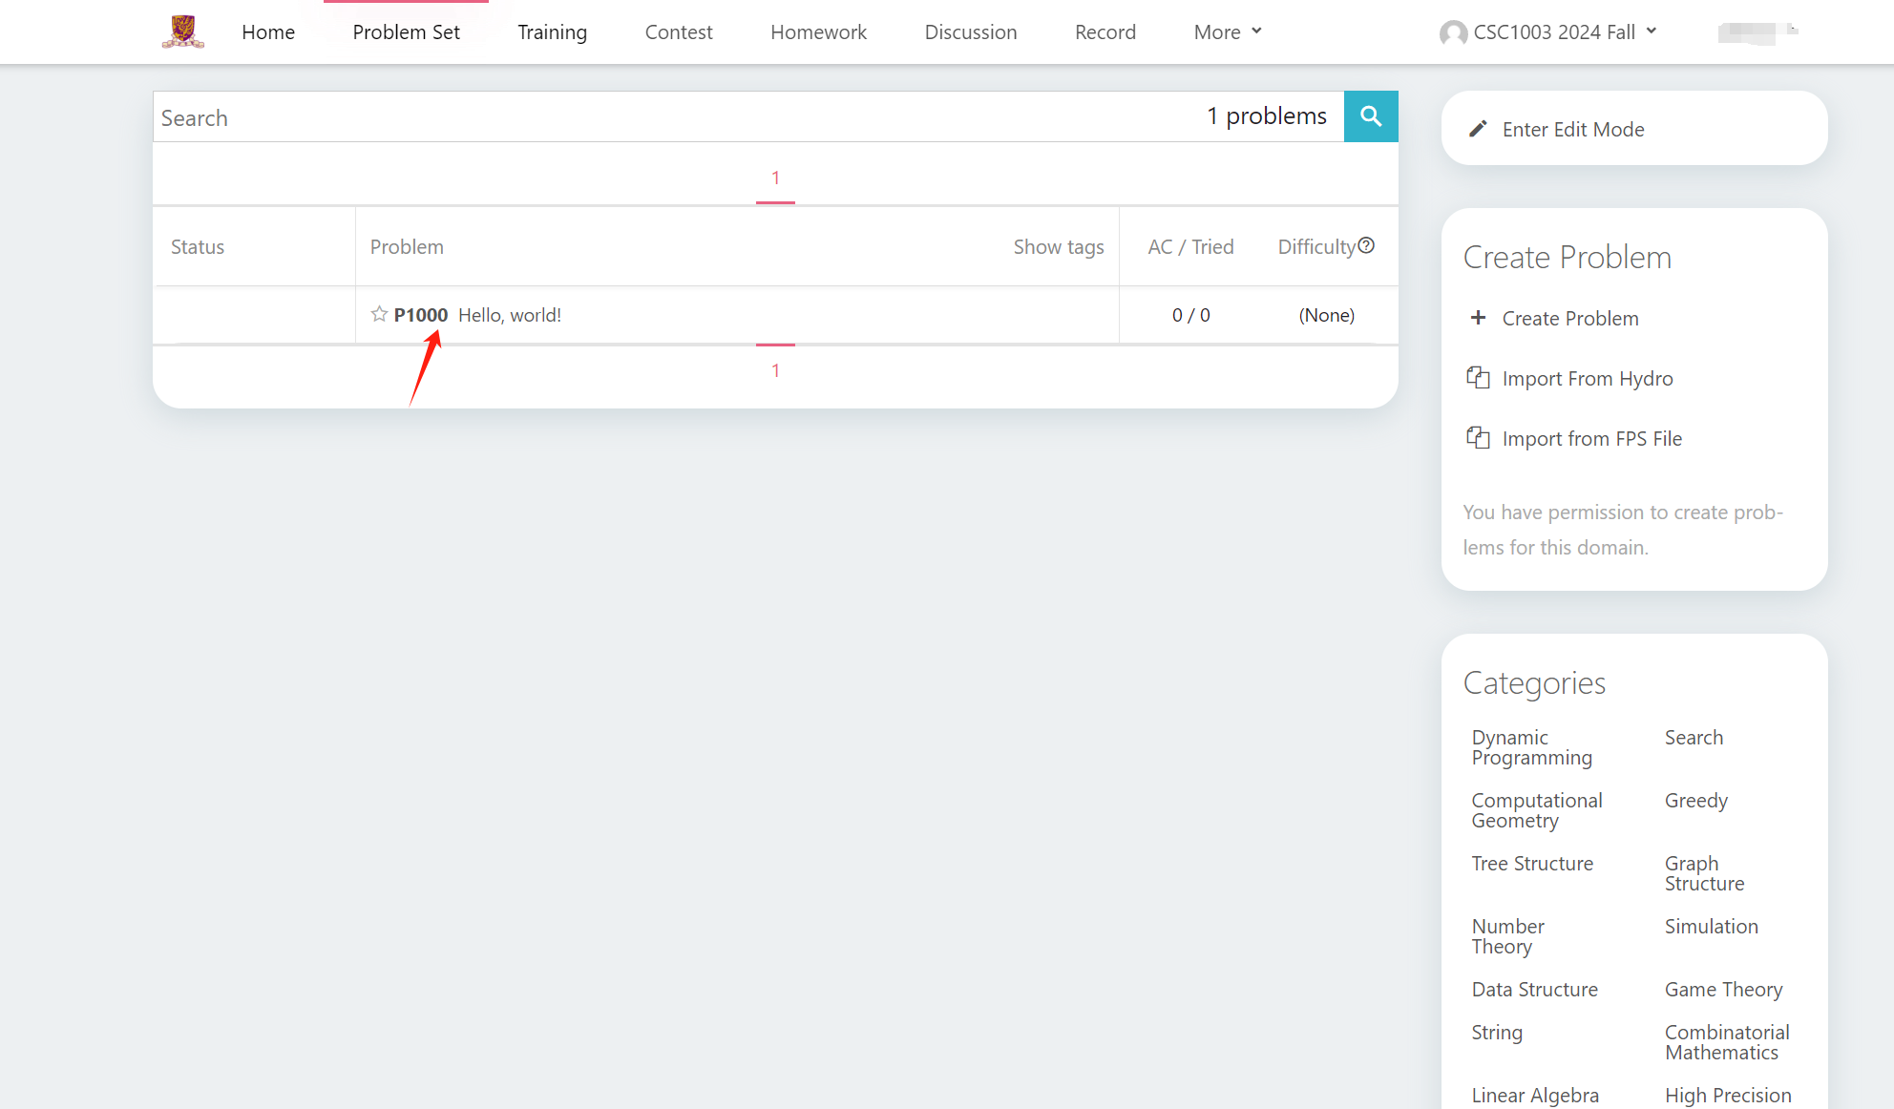
Submission on OJ
  Select a Problem:

Slide 10
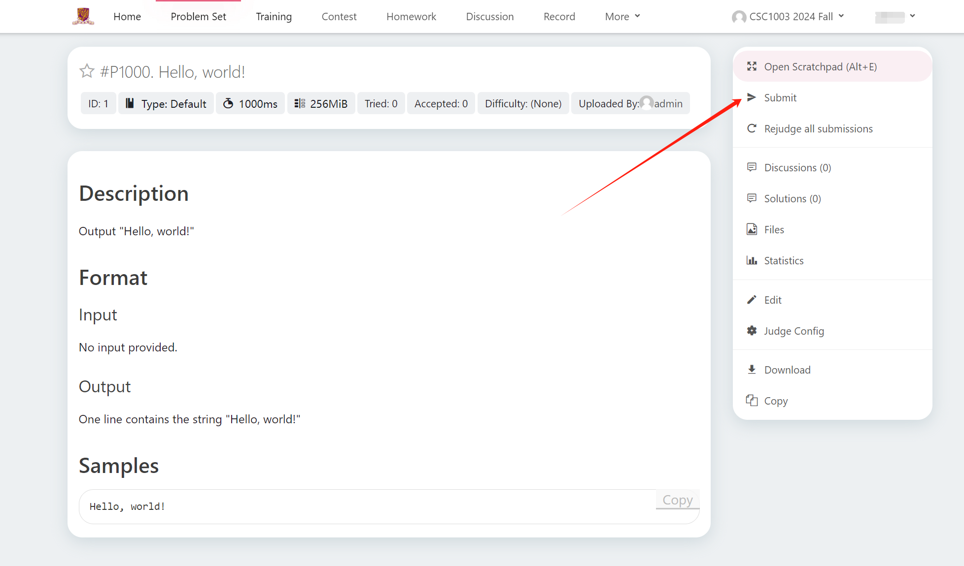
Submission on OJ
  Click “Submit”:

Slide 11
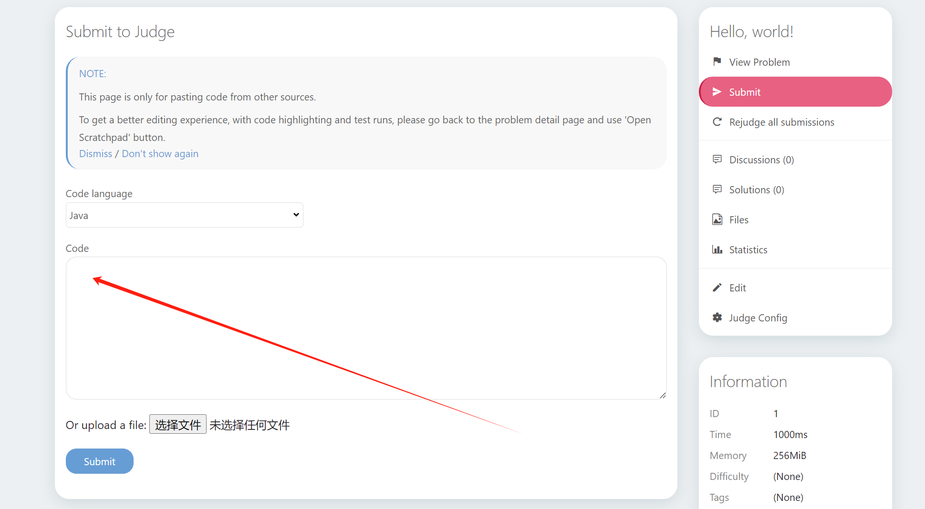
Submission on OJ
  Paste your code here:

Slide 12
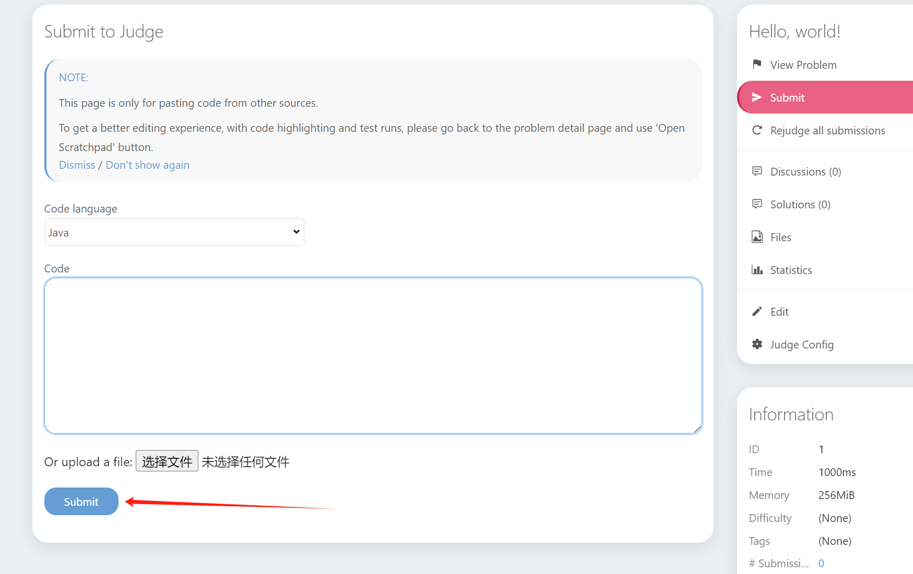
Submission on OJ
  Click “Submit”:

Slide 13
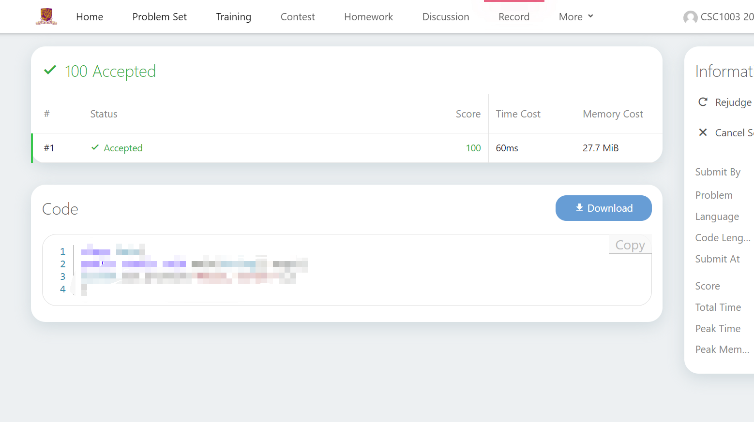
Submission on OJ
  View your results:

Slide 14
Grading Rules
  0 point
Error occurs
Use “System.out.print/println”
  Input
Your Program
  Output
  AC
  (full points)
Same
(multiple test cases)
Use “Scanner”:
https://www.w3schools.com/java/java_user_input.asp
Compare
  Standard Output
Different
  WA
  (0 point)

Slide 15
Grading Rules
  2 kinds of test cases:
    Pre-test cases:
      Available before the due date
      Used to self-test your program
      Not counted into the assignment score
    Real test cases:
      Not visible by students
      Used to grade your program
      Score of a case is given if and only if the result is “AC”

Slide 16
Grading Rules
  Example:
    A question has 2 pre-test cases and 10 real test cases;
    Your program passes 2 pre-test cases;
    Among 10 real test cases (10 points each), 6 are “AC” and 4 are others (WA, MLE, TEL, etc.);
    Your score for this question is 10 * 6 = 60.

Slide 17
Grading Rules
  Additional Rules:
    1. The score you get for assignments is based on your code submitted on OJ;
    2. You also need to submit your code on blackboard, or you will get 0 for this assignment.
    3. When submitting on blackboard, please directly submit your .java files. You will also get 0 if you submit in other forms.
    4. Late submission will not be accepted.

Slide 18
Grading Rules
  The rule of compare your program’s output with standard output: all characters should be the same except extra blank lines and spaces at the end of the output
  Standard output (use “_” to represent space):
1,_2,_3
4,_5,_6
1,_2,_3
4,_5,_6
(blank line)
1,_2,_3
4,_5,_6_
1,_2,_3
4,_5,_6_____
(blank line)
  Acceptable outputs:
  Wrong outputs:
  ( only extra spaces at the end are tolerated )
1,_2,_3_
4,_5,_6
1,_2,_3
(blank line)
4,_5,_6
1,2,3
4,5,6

Slide 19
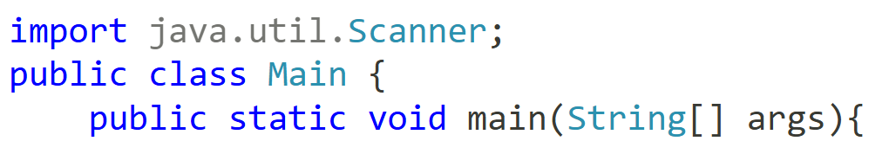
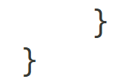
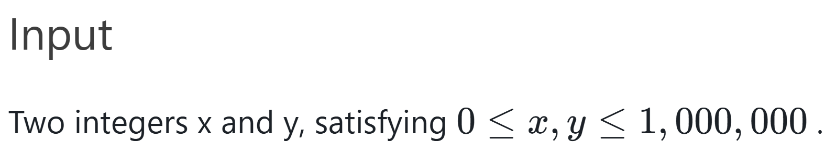
Notes
  Your code should begin with “public class Main” (capital M);
    Example:
    // your code here
    Your score is based on the 10 hidden test cases,
      NOT the test cases that you see in the examples (so, make sure your code works within the problem scope) ➔ See example below.

Slide 20
Practice on OJ
  Helloworld: https://oj.cuhk.edu.cn/d/csc1003_2025_fall/p/P1000
  A+B Problem: https://oj.cuhk.edu.cn/d/csc1003_2025_fall/p/P1001

Slide 21
Q&A

